Slide 1
Lesson 02—Data Connections

Slide 2


What’s In It For Me
List the methods to prepare data for Tableau
Describe how to connect data to Tableau
Explain how the Tableau data engine optimizes performance
Understand how to create and use data extracts

Slide 3
Data Connections
Topic 1: Preparing Data for Tableau

Slide 4







Preparing Data for Tableau
TABLEAU TOOLS
It is important to format data before it can be analyzed using Tableau; this helps to save time and prevent
errors.
Tableau offers the following tools to help prep data for analysis:
Data
Data
Splits
Metadata
Pivot
Union
Data
Joins
Blending
Grid View
Interpreter
(From one or
more databases)

Slide 5






Preparing Data for Tableau
DATA JOINS
A dataset is typically made up of a collection of tables related by specific fields or columns.
The Joining method is used to combine the related data in those common fields.
A Join results in a virtual table that is typically extended horizontally by adding columns.

Slide 6
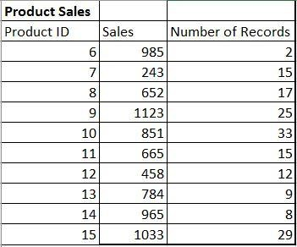
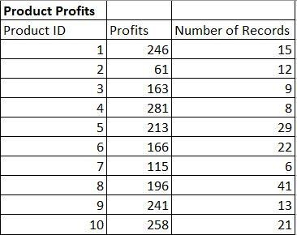
Preparing Data for Tableau
DATA JOINS: EXAMPLE
Shown here is the analysis of data on product sales with two files:
Product Sales: LEFT Table Product Profits: RIGHT TABLE
The product ID field serves as the primary key to join the data from the two sets.

Slide 7
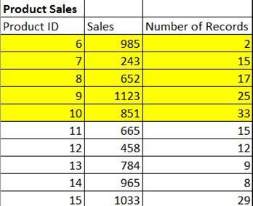
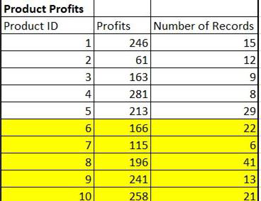

Preparing Data for Tableau
TYPES OF JOINS
The resulting table includes data that is present in BOTH data sets.
Inner
Venn Diagram
Left
Right
Full Outer

Slide 8

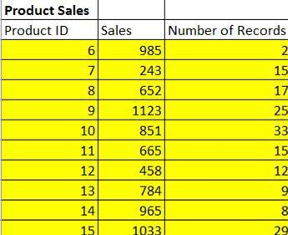
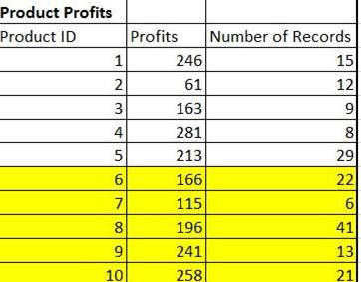
Preparing Data for Tableau
TYPES OF JOINS
The resulting table contains all values from the LEFT table and any matches from the RIGHT table.
When a value in the LEFT table doesn’t have a corresponding match in the RIGHT table, you see a null
value in the data grid.
Inner
Venn Diagram
Left
Right
Full Outer

Slide 9

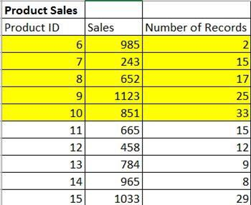
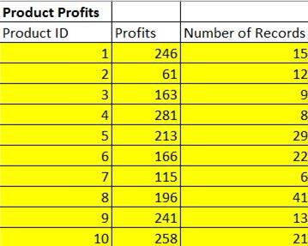
Preparing Data for Tableau
TYPES OF JOINS
The resulting table contains all values from the RIGHT table and any matches from the LEFT table.
When a value in the RIGHT table doesn’t have a corresponding match in the LEFT table, you see a null
value in the data grid.
Inner
Venn Diagram
Left
Right
Full Outer

Slide 10
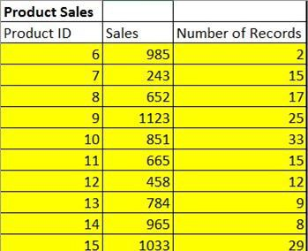
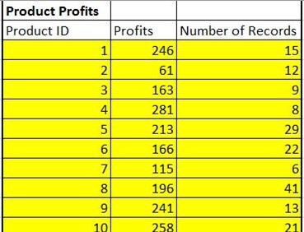

Preparing Data for Tableau
TYPES OF JOINS
The resulting table contains all values from BOTH tables. When a value from EITHER table doesn't have a match with the other table, you see a null value in the data grid.
Inner
Venn Diagram
Left
Right
Full Outer

Slide 11
Preparing Data for Tableau
JOINS FROM DATABASE
Tableau facilitates creating joins in two ways:
Single database joins
Cross database Joins

Slide 12

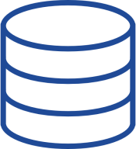
Preparing Data for Tableau
SINGLE DATABASE JOINS
Joining tables from the same database requires only a single connection in the data source.
Tableau Data Engine
Database

Slide 13
Demo—Perform a Single Database Join

Slide 14
Preparing Data for Tableau
CROSS DATABASE JOINS
Cross-database Joins require setting up a multi-connection data source by creating a new connection
to each database.
Multi-connection data sources are helpful when different internal systems are used.
Database 1
Tableau Data Engine
Database 2

Slide 15
Demo—Perform a Cross Database Join

Slide 16

Data Blending
Blending is a method of combining related data from multiple sources in a single view in order to analyze it.
There is always one primary data source, while the rest become secondary data sources.
Primary Data Source
Secondary Data Source
Secondary Data Source
Tableau identifies common dimensions within the data sources so that the user knows which fields can be used.
Blending does not create joins at the row level; instead, it automatically creates an outer join to the secondary source(s).

Slide 17
Data Blending
BLEND VS JOIN
When to use a Blend:
When to use a Join:
You have to combine data from different databases that do not support cross-table joins.
Data within the different sources are at different levels of detail.
Using a Join causes duplicate rows.
You are working with large amounts of data
Your data format is consistent across all sources.
You are working with relatively small
amounts of data.
Data within each source is at the same level of detail.

Slide 18
Splits
Splitting data from one field into multiple columns is used often in data preparation.
Example:
City:
Denver
City/State:
Denver CO
State:
CO
This was typically remedied in Excel with the “Text to Columns” function.

Slide 19
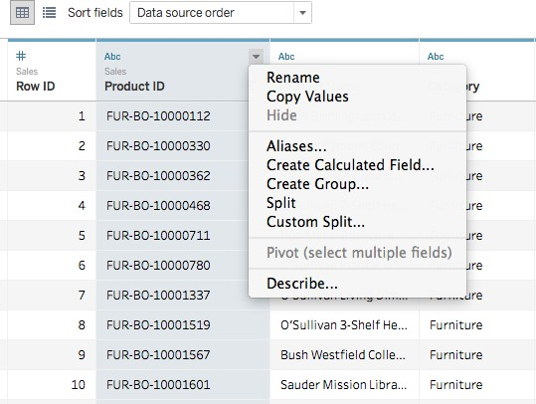
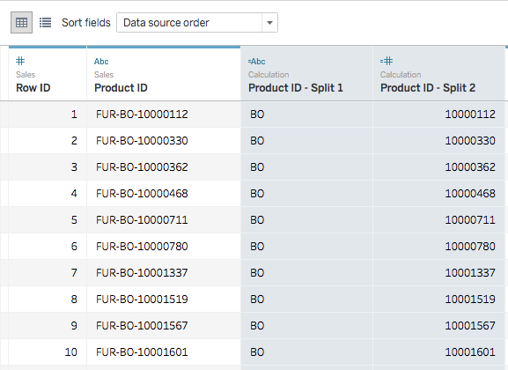
Splits
AUTOMATIC SPLITS
A string field can be split automatically based on a common separator that Tableau detects (space or underscore).
This split can be used to automatically separate a field’s value into a maximum of ten new fields,
depending on the type of data connection.

Slide 20
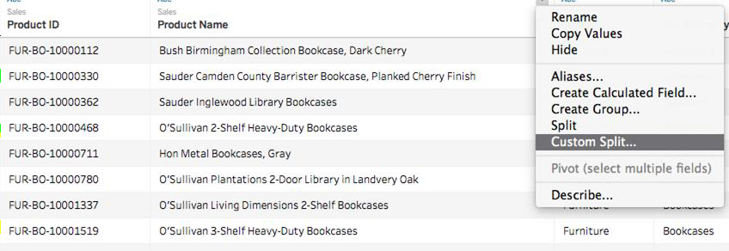
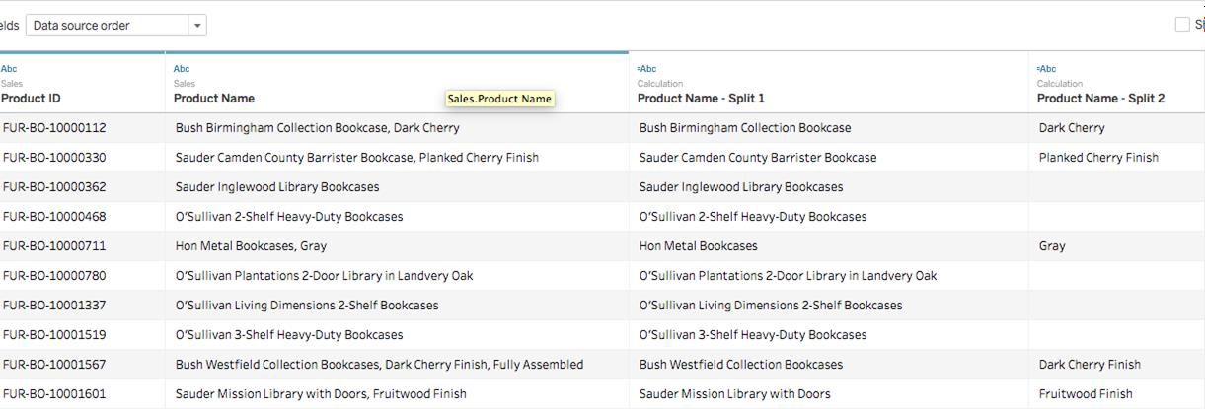
Splits
CUSTOM SPLITS
The custom split can also separate a string field into a maximum of ten new fields based on a separator within the original field.

Slide 21
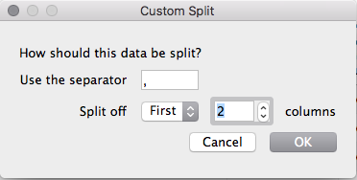
Splits
CUSTOM SPLITS
You can choose to split the values at:
The first n occurrences of the separator
The last n occurrences of the separator
All the occurrences of the separator
Last All
Last
All

Slide 22

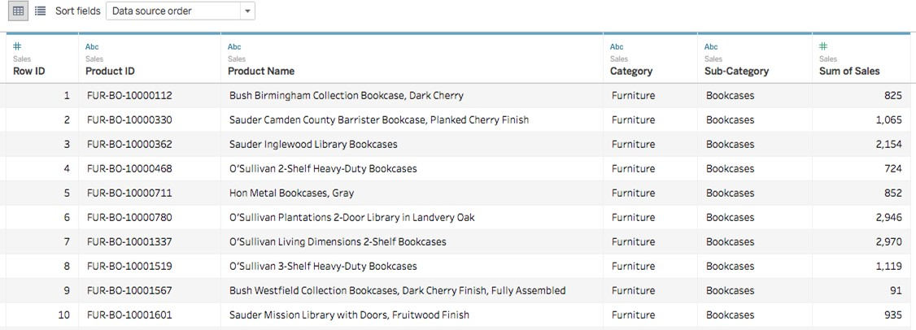
Metadata Grid
When preparing data for analysis, a list of fields is sometimes more useful than the data preview.
The Metadata Grid view in Tableau allows you to quickly perform actions, such as rename, hide, and
others, on multiple fields with a single command.

Slide 23
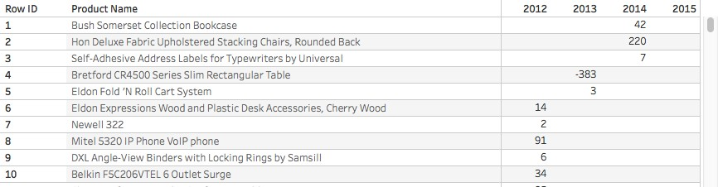
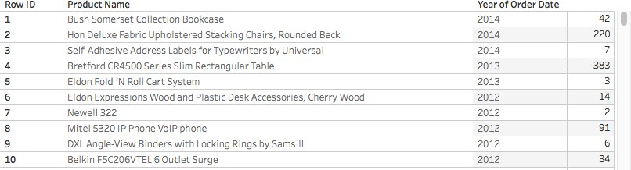
Pivot
Data is often not organized as a typical data set: field names along the columns and members along the rows.
Example:
The Pivot function in Tableau allows you to select the columns you want to manipulate and format them into a typical data set ready for analysis.

Slide 24
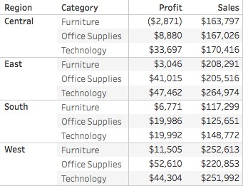




Union
Data often also resides in multiple, separate files and may need to be combined into a “master file.”
Tableau’s “Union” feature helps you assemble data from multiple small files into one large file.

Slide 25
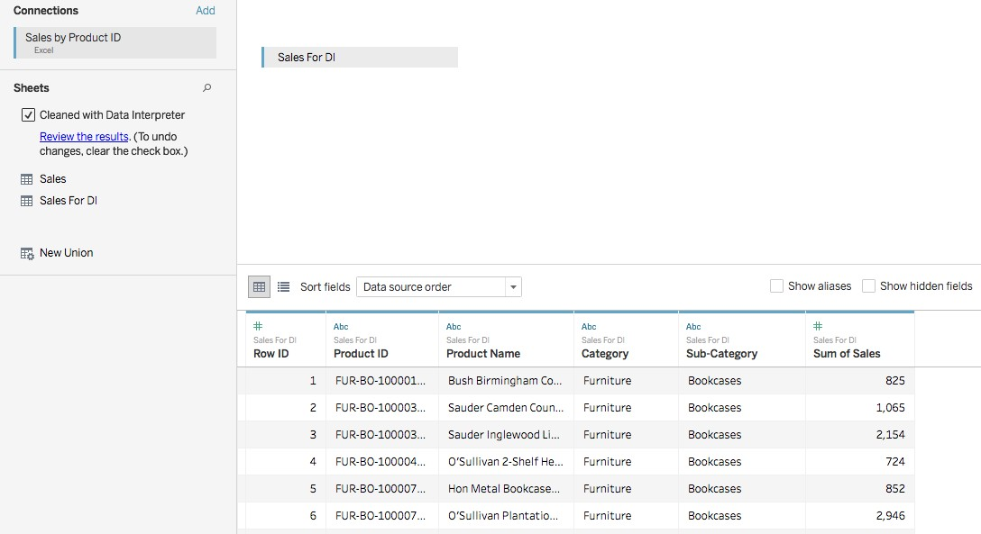
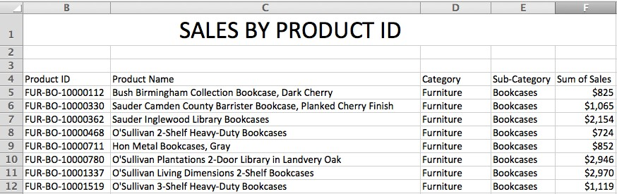
Data Interpreter
This function automatically “cleans” your data and preps it for analysis.
Examples of items that need to be cleaned prior to analysis:
Merged cells
Titles
Footnotes
Blank rows or columns

Slide 26
Data Connections
Topic 2: Connecting Data to Tableau

Slide 27




Connecting Data to Tableau
We can connect data to Tableau in one of the following ways:
Data sources published to Tableau Server
Queries
Web data through web data connectors
Local files

Slide 28



Connecting Data to Tableau
TABLEAU SERVER
With a Tableau Server deployment, you can:
post and access data sources published to an instance of Tableau server
connect to the data “live” or generate an extract from the
data source
schedule automatic data extract refreshes
Data sources published to Tableau Server
Queries
Web data through web data connectors
Local files

Slide 29
Demo—Connecting to a Data Source Through Tableau Server

Slide 30
Connecting Data to Tableau
SQL QUERIES
You can create a connection to an SQL database such as MySQL or Microsoft SQL
Server.
Data sources published to Tableau Server
Queries
Web data through web data connectors
Local files

Slide 31
Connecting Data to Tableau
WEB DATA CONNECTORS
With Tableau, you can connect to applications such as Google Analytics, Market, Salesforce, and others.
For other applications, Tableau includes a wizard for building custom web data connectors.
Data sources published to Tableau Server
Queries
Web data through web data connectors
Local files

Slide 32
Connecting Data to Tableau
LOCAL FILES
These can be
Text files
Spreadsheets
Statistical files such as SAS, tab/character delimited
Tableau extracts/workbooks/data sources
Data sources published to Tableau Server
Queries
Web data through web data connectors
Local files

Slide 33
Demo—Connecting to Flat Files

Slide 34
Data Connections
Topic 3: Methods of Performance Optimization

Slide 35
Methods of Performance Optimization
Running Queries in Parallel
RUNNING QUERIES IN PARALLEL
Running queries in parallel instead of serially is an effective way to boost performance.
Data Engine Vectorization
Sub-Query Execution
Disk
External Query Caching
End User Query
Sub-Query
Execution
Disk
Sub-Query Execution
Query Fusion
Disk

Slide 36
Methods of Performance Optimization
Running Queries in Parallel
DATA ENGINE VECTORIZATION
Data Engine Vectorization
Tableau’s data engine takes advantage of vector instructions on current processors.
The data engine uses SIMD instructions to perform low-level operations such as plus, minus, divide, min, max, sum, etc., on multiple data in parallel.
External Query Caching
This means that basic computations can be performed more quickly.
Query Fusion

Slide 37
Methods of Performance Optimization
Running Queries in Parallel
EXTERNAL QUERY CACHING
Data Engine Vectorization
Tableau saves query results from the previous time the dashboard was opened.
A single short query is run to fetch the cache data when the workbook is opened.
External Query Caching
Query Fusion

Slide 38
Methods of Performance Optimization
Running Queries in Parallel
QUERY FUSION
Data Engine Vectorization
This is a technology for database connections that looks at all of the queries in the dashboard
and finds ways to consolidate them into fewer queries.
External Query Caching
Query Fusion

Slide 39
Data Connections
Topic 4: Tableau Data Extract Capabilities

Slide 40




Tableau Data Extracts
Data from your data source can be “extracted” into a file called a Tableau data extract; it
transforms data into a Tableau-friendly format, improving query efficiency.
Custom filters can limit the scope of information included in an extract.
Custom aggregations can minimize the amount of data loaded into the extract.
Tableau includes functionalities for creating data extracts that are compact and offer lightning-fast performance:
Extract refreshes can be executed through a schedule (with Tableau Server).
Extracts can also be published to Tableau Server for sharing.

Slide 41
Demo—Creating a Data Extract

Slide 42
QUIZ

Slide 43


QUIZ
1
When should you use a Blend instead of a Join to combine data?
a.
Data within the sources are at different levels of detail
b.
You are working with large data sets
c.
You need to combine data from sources that don’t support cross-table joins
d.
All of the above

Slide 44

QUIZ
1
When should you use a Blend instead of a Join to combine data?
a.
Data within the sources are at different levels of detail
b.
You are working with large data sets
c.
You need to combine data from sources that don’t support cross-table joins
d.
All of the above
The correct answer is d.
In each of these situations, you should consider using a Blend instead of a Join to combine data from different databases.

Slide 45
QUIZ
2
The Tableau function separates a string field into multiple string fields.
a.
Union
b.
Join
c.
Split
d.
Data Interpreter

Slide 46
QUIZ
2
The Tableau function separates a string field into multiple string fields.
a.
Union
b.
Join
c.
Split
d.
Data Interpreter
The correct answer is c.
The Split function is used to separate a string field into multiple string fields.

Slide 47
QUIZ
3
Technology for database connections that will look at all of the queries in your dashboard and find ways to consolidate them into fewer queries is called .
a.
Query fusion
b.
Parallel aggregation
c.
Data Engine Vectorization
d.
Query optimization

Slide 48
QUIZ
3
Technology for database connections that will look at all of the queries in your dashboard and find ways to consolidate them into fewer queries is called .
a.
Query fusion
b.
Parallel aggregation
c.
Data Engine Vectorization
d.
Query optimization
The correct answer is a.
Query fusion is a technology that examines all queries in your dashboard and consolidates them to reduce the number of queries hitting your processors.

Slide 49
Problem Statement
Genelia needs to analyze Sales data for her company, and the data she needs is coming from multiple databases. The data sources include Excel spreadsheet files, an SQL database, and Salesforce.com. Additionally, the data is at different levels of detail and forms an extremely large data set.
Which tools should she consider to prepare the data for analysis?
Should she attempt to combine the data with a Blend or a Join?
What steps should she consider to ensure that queries are executed efficiently?

Slide 50
Solution
Which tools should she consider to prepare the data for analysis?
Genelia should consider the Union functionality to combine the Excel-based data.
She should use the Pivot functionality to align the levels of detail within the different databases.
Should she attempt to combine the data with a Blend or a Join?
Given that she is working with a large set of data, and the data sources are at different levels of
detail, she should use a Blend to combine the data.
What can she do to ensure his queries are executed efficiently?
Genelia should consider creating a Tableau data extract and filter out data that is not necessary
for this analysis. This will improve the performance of her queries.

Slide 51




Key Takeaways
Data is rarely clean, tidy, and complete, and it is typically not in
one file or even one type of file.
A good BI professional takes her time to understand data prior to using it for analysis with a BI tool like Tableau.
Tableau offers a suite of functions that help the user automate as much of the data preparation as possible.
Tableau can point to several different types of files—from a simple Excel file to a custom, complex SQL database
Data extracts in Tableau come in very handy as they can boost performance, get refreshed automatically, and limit the scope of your data.

